Slide 1
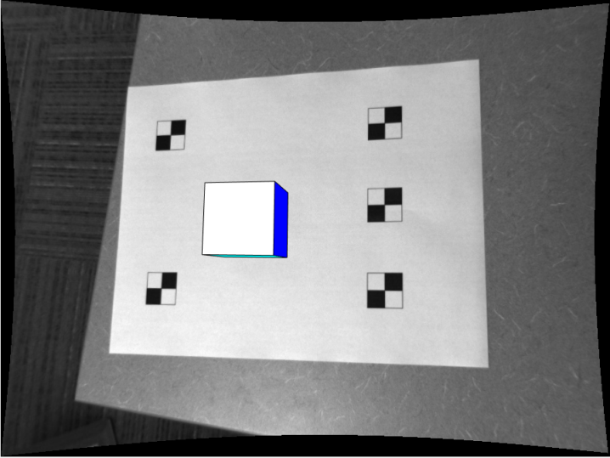
Final Project Augmented Reality
Colin Bunker

Slide 2
Camera Calibration
Used Zhang’s 2 step method
Find checkerboard corners
Correlate corners to real-world positions
Calculate closed-form K, R, and t
Levenberg-Marquardt to find better estimate and calculate radial distortion
Derivation is in my Final Project PDF

Slide 3
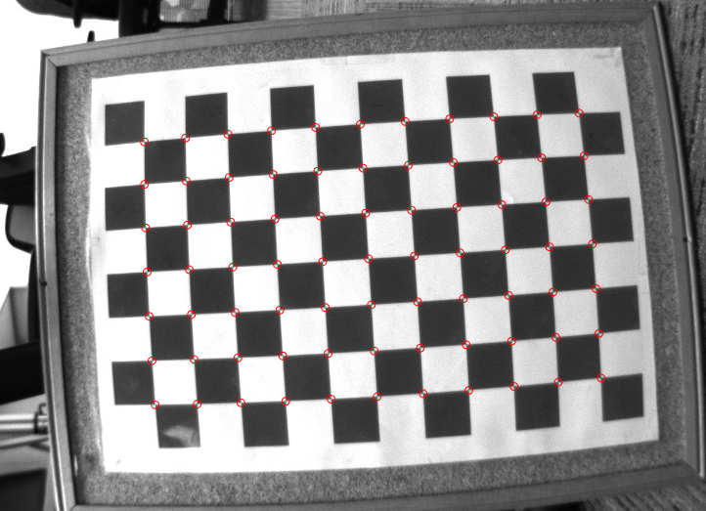
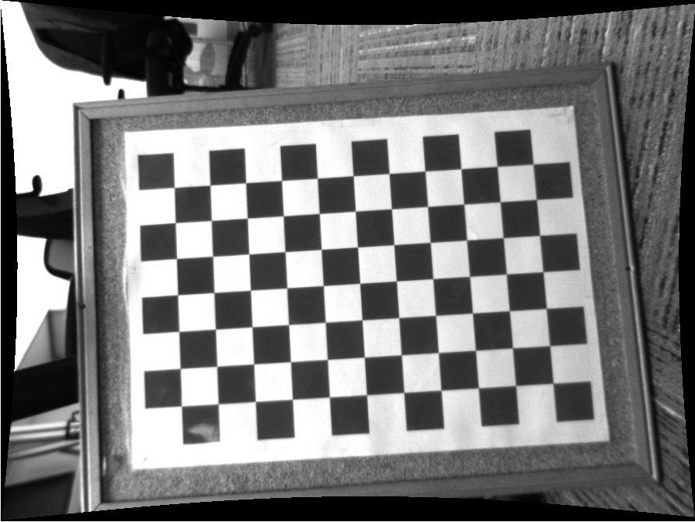
Camera Calibration
Intrinsics, Rotation, translation
Closed-Form Equations
Nonlinear Optimization
Better Intrinsics, Rotation, translation
Radial Distortion
Undistort

Slide 4
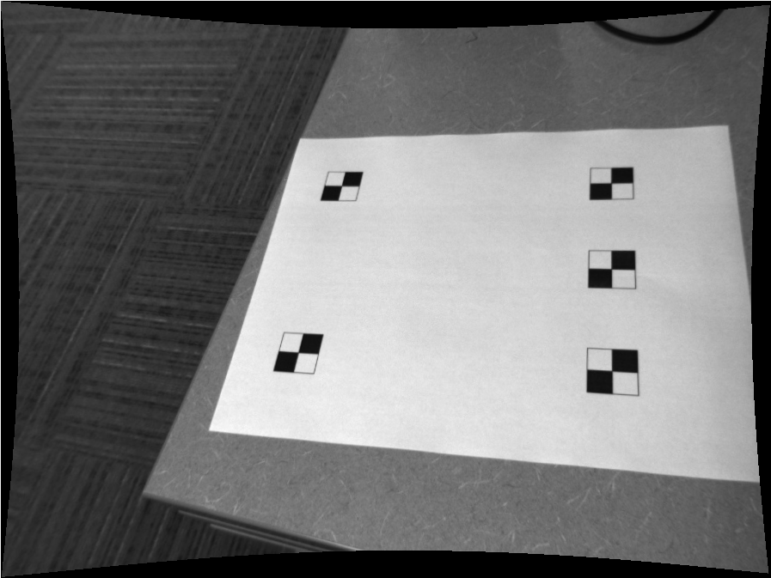
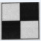
Locating Fiducial Points
Calculate Normalized Cross Correlation between Fiducial Marker and Image
Non-maxima suppression
5 greatest maxima locations = 5 fiducial locations

Slide 5
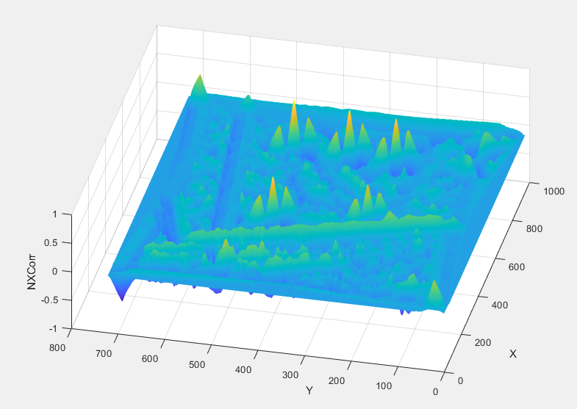
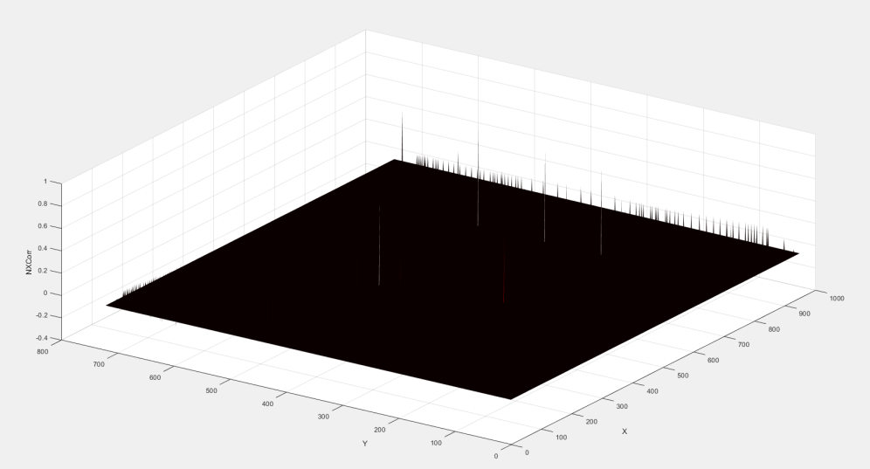
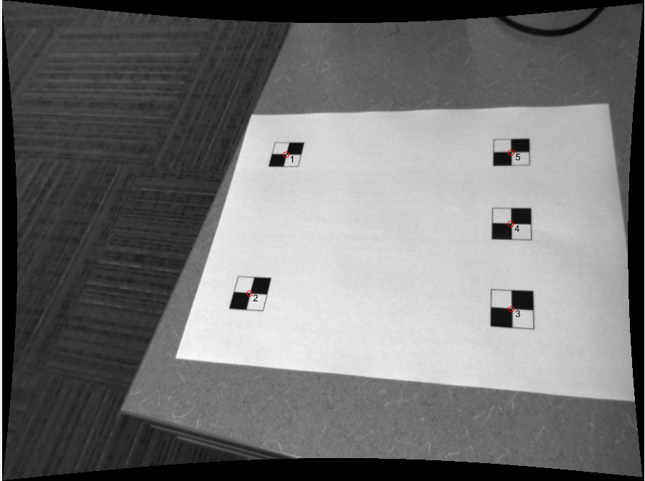
Locating Fiducial Points
Normalized Cross Correlation
Non-maxima Suppression

Slide 6
Locating Fiducial Points

Slide 7
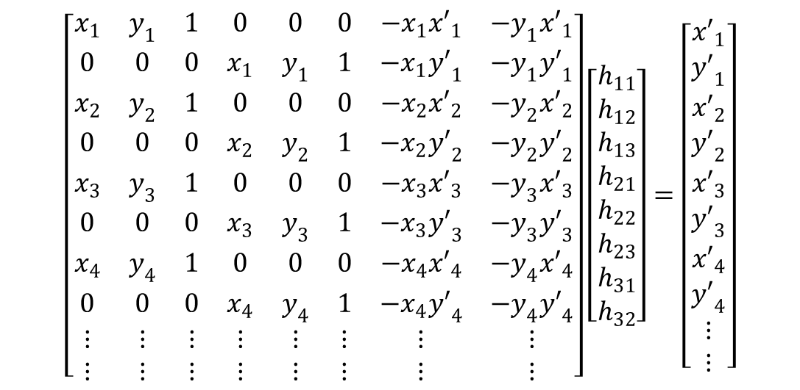
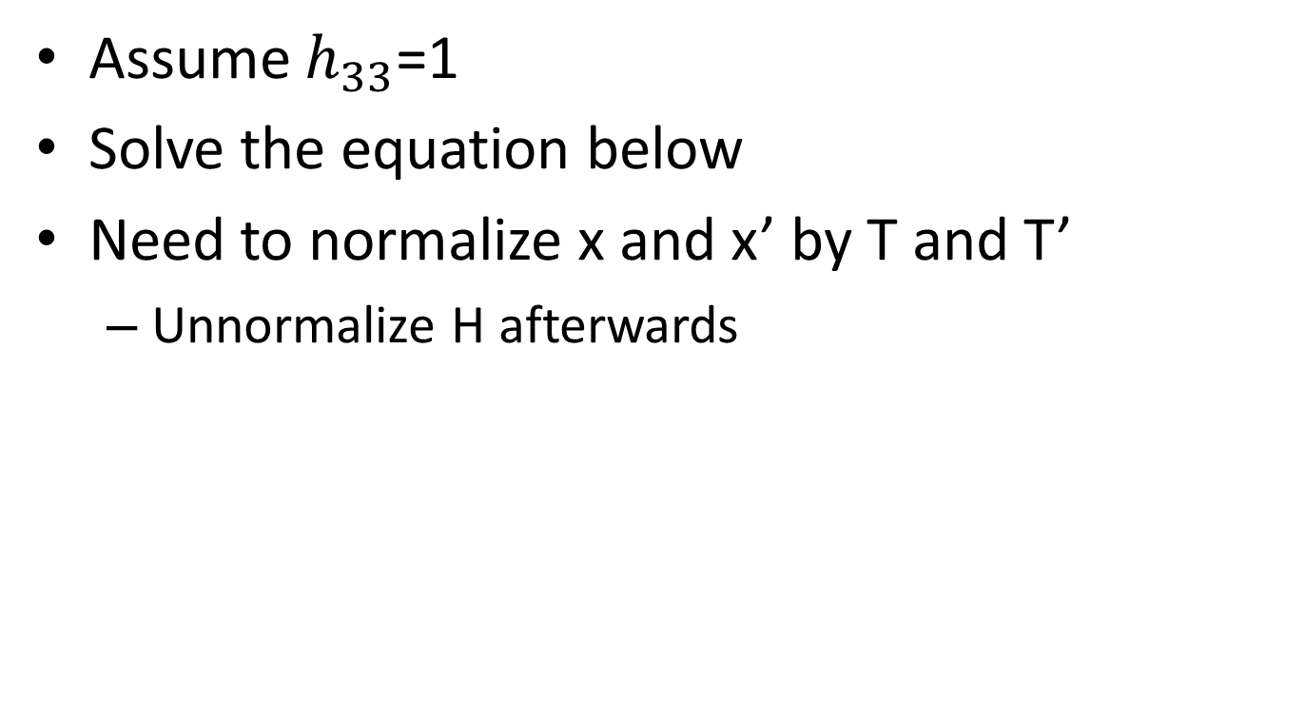
Homography Calculation
Assume $h_{33}$=1
Solve the equation below
Need to normalize x and x’ by T and T’
Unnormalize H afterwards
$$\left[\begin{matrix}x_{1} & y_{1} & 1 & 0 & 0 & 0 & −x_{1}{x′}_{1} & −y_{1}{x′}_{1} \\ 0 & 0 & 0 & x_{1} & y_{1} & 1 & −x_{1}{y′}_{1} & −y_{1}{y′}_{1} \\ x_{2} & y_{2} & 1 & 0 & 0 & 0 & −x_{2}{x′}_{2} & −y_{2}{x′}_{2} \\ 0 & 0 & 0 & x_{2} & y_{2} & 1 & −x_{2}{y′}_{2} & −y_{2}{y′}_{2} \\ x_{3} & y_{3} & 1 & 0 & 0 & 0 & −x_{3}{x′}_{3} & −y_{3}{x′}_{3} \\ 0 & 0 & 0 & x_{3} & y_{3} & 1 & −x_{3}{y′}_{3} & −y_{3}{y′}_{3} \\ x_{4} & y_{4} & 1 & 0 & 0 & 0 & −x_{4}{x′}_{4} & {−y}_{4}{x′}_{4} \\ 0 & 0 & 0 & x_{4} & y_{4} & 1 & −x_{4}{y′}_{4} & −y_{4}{y′}_{4} \\ ⋮ & ⋮ & ⋮ & ⋮ & ⋮ & ⋮ & ⋮ & ⋮ \\ ⋮ & ⋮ & ⋮ & ⋮ & ⋮ & ⋮ & ⋮ & ⋮\end{matrix}\right]\left[\begin{matrix}h_{11} \\ h_{12} \\ h_{13} \\ h_{21} \\ h_{22} \\ h_{23} \\ h_{31} \\ h_{32}\end{matrix}\right]=\left[\begin{matrix}{x′}_{1} \\ {y′}_{1} \\ {x′}_{2} \\ {y′}_{2} \\ {x′}_{3} \\ {y′}_{3} \\ {x′}_{4} \\ {y′}_{4} \\ ⋮ \\ ⋮\end{matrix}\right]$$

Slide 8
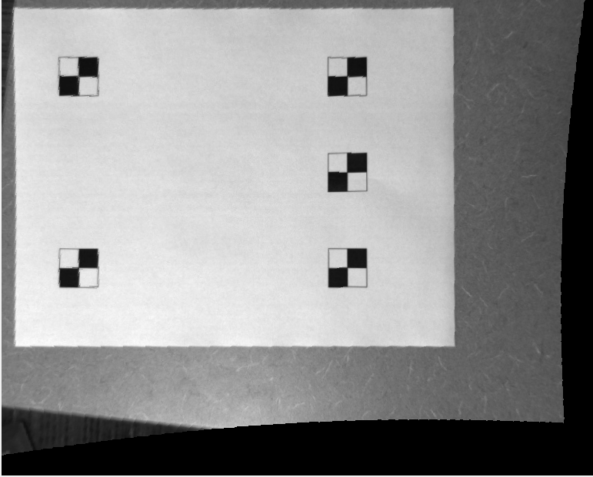
Homography Calculation

Slide 9
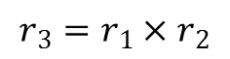
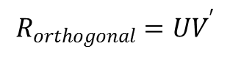
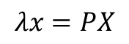
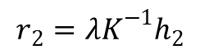
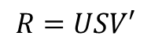
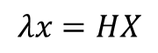
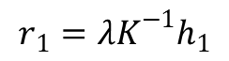
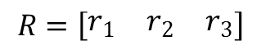
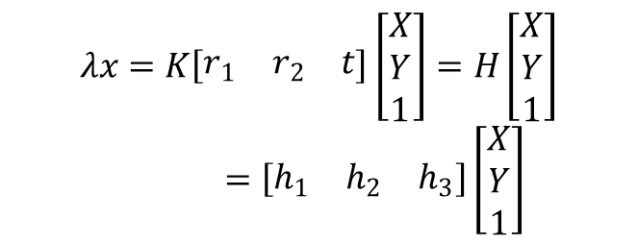
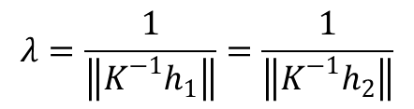
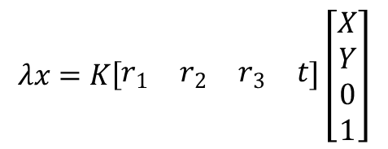
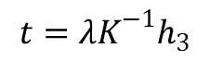
Resectioning
Similar to calibration task
$$r_{1}={λK}^{−1}h_{1}$$
$$λx=PX$$
$$λx=HX$$
$$r_{2}={λK}^{−1}h_{2}$$
$$λx=K\left[\begin{matrix}r_{1} & r_{2} & r_{3} & t\end{matrix}\right]\left[\begin{matrix}X \\ Y \\ 0 \\ 1\end{matrix}\right]$$
$$r_{3}=r_{1}×r_{2}$$
$$t={λK}^{−1}h_{3}$$
$$λ=\frac{1}{\left\|K^{−1}h_{1}\right\|}=\frac{1}{\left\|K^{−1}h_{2}\right\|}$$
$$λx=K\left[\begin{matrix}r_{1} & r_{2} & t\end{matrix}\right]\left[\begin{matrix}X \\ Y \\ 1\end{matrix}\right]=H\left[\begin{matrix}X \\ Y \\ 1\end{matrix}\right]=\left[\begin{matrix}h_{1} & h_{2} & h_{3}\end{matrix}\right]\left[\begin{matrix}X \\ Y \\ 1\end{matrix}\right]$$
$$R=\left[\begin{matrix}r_{1} & r_{2} & r_{3}\end{matrix}\right]$$
$$R=USV′$$
$$R_{orthogonal}=UV^{′}$$

Slide 10
Polygon Drawing
Sorted faces by distance to pinhole (farthest to closest)
Draw faces in this order
Project 3D vertex points to image 2D coordinates

Slide 11
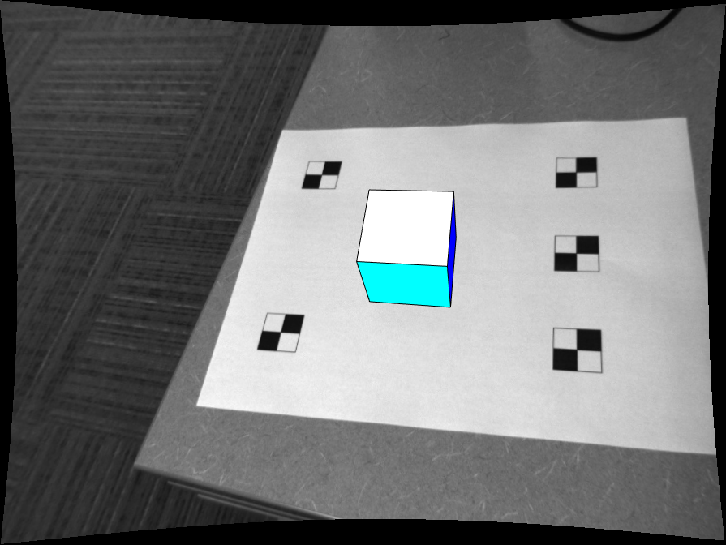
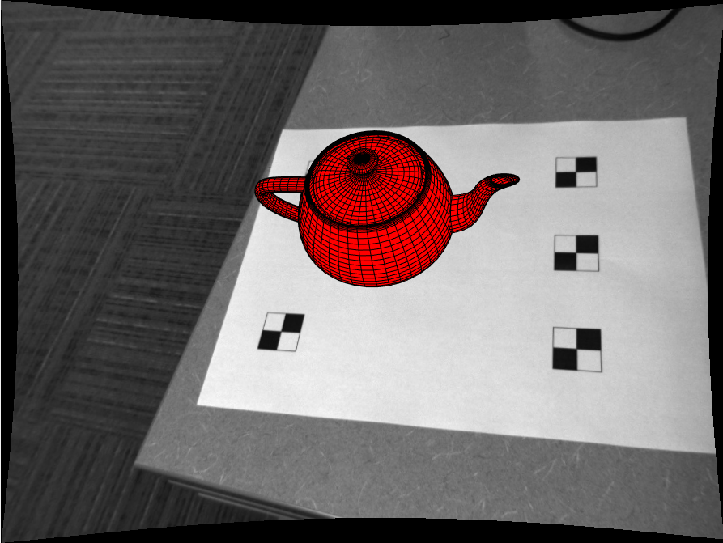
Results

Slide 12
Bonus
Find SURF Features in both images
Match Features
Perform RANSAC to find dominating plane
Remove these inliers
Perform RANSAC again to find second plane

Slide 13
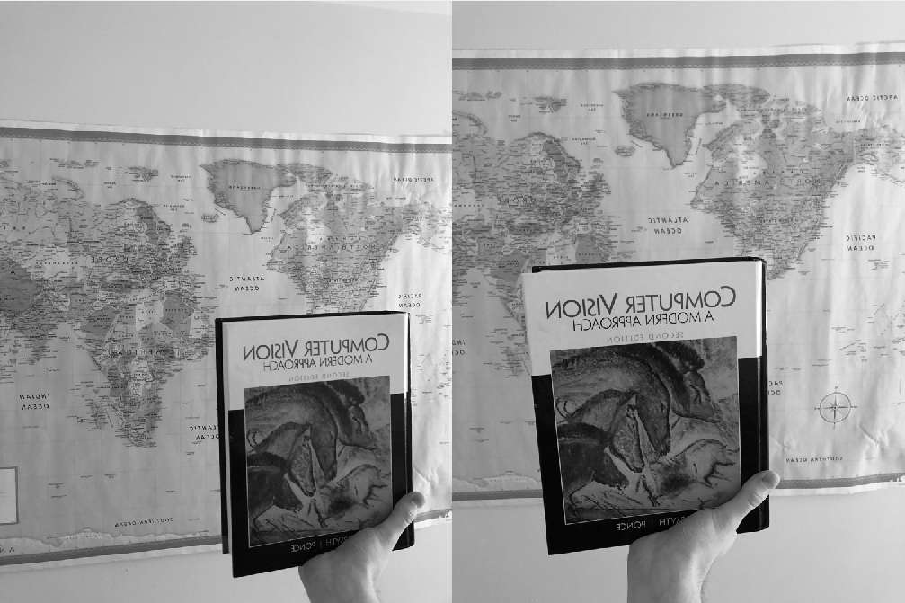
Bonus

Slide 14
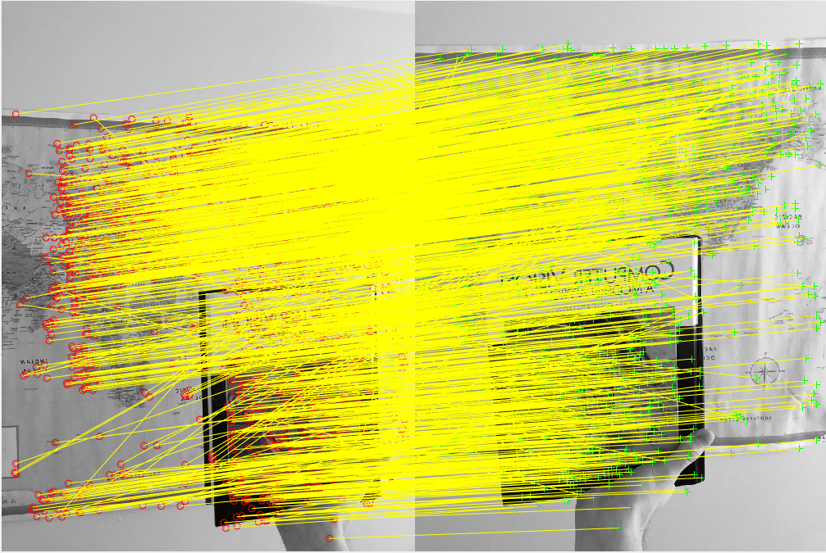
Bonus

Slide 15
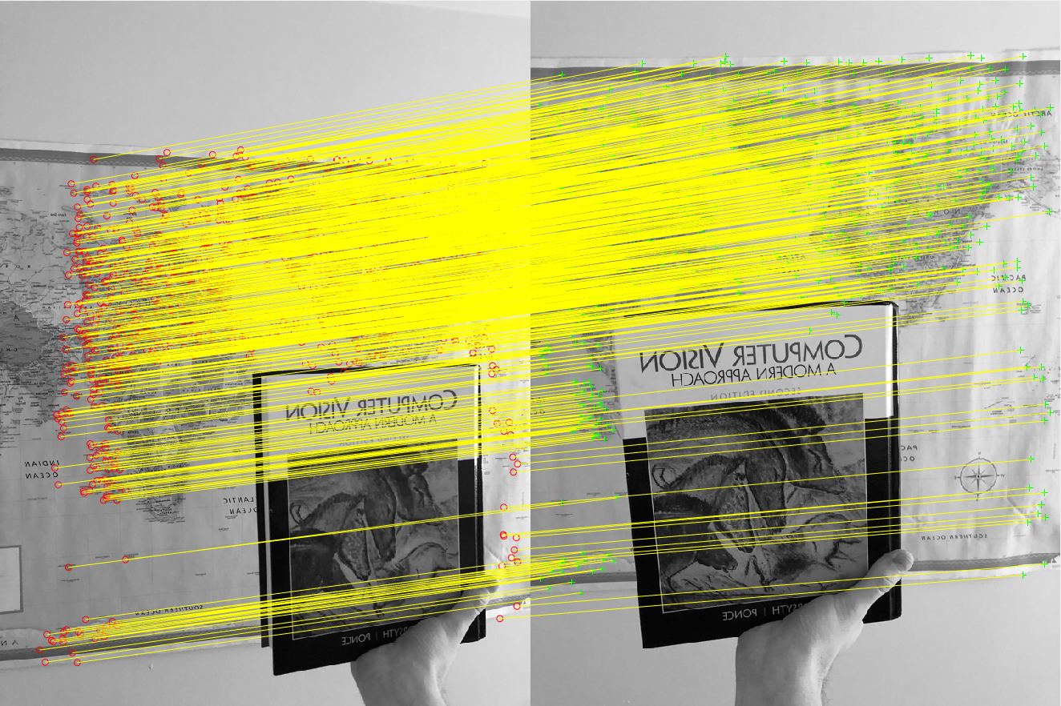
Bonus
First Plane

Slide 16
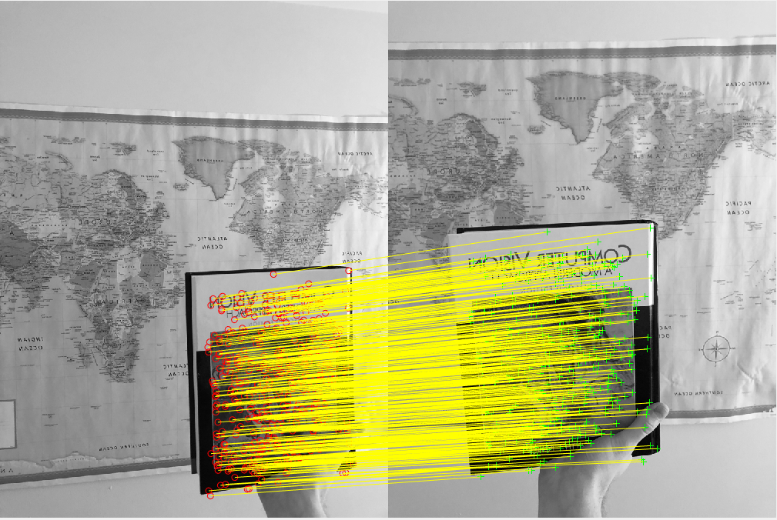
Bonus
Second Plane

Slide 17

Bonus

Slide 18
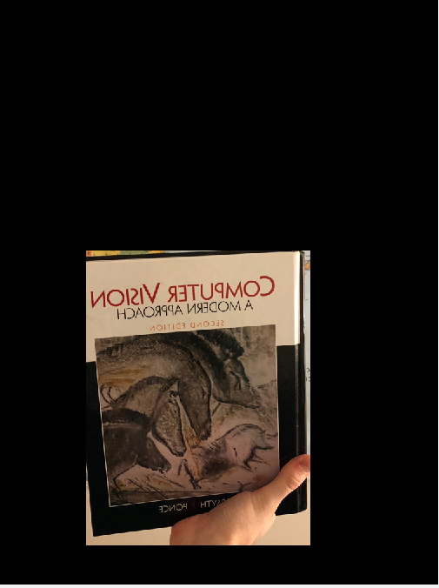
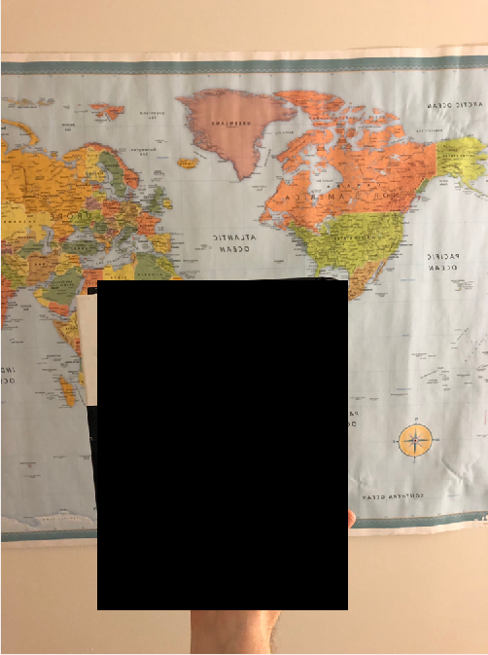
Bonus

